Slide 1
Low-power HDL techniques
ECE381(CAD), Lecture 12:
Mehdi Modarressi
Department of Electrical and Computer Engineering,
University of Tehran

Slide 2
Why Low-power?
Battery powered systems
Higher integration
Cost of packaging and fans
Reliability (component wear-out)
Hot spots (thermal management)

Slide 3
Power Components
Dynamic
  Switching Power: Caused by switching activity
Static
  Consumed even when no computations are carried out
    Reverse Leakage Power
    Sub-threshold Leakage Power

Slide 4

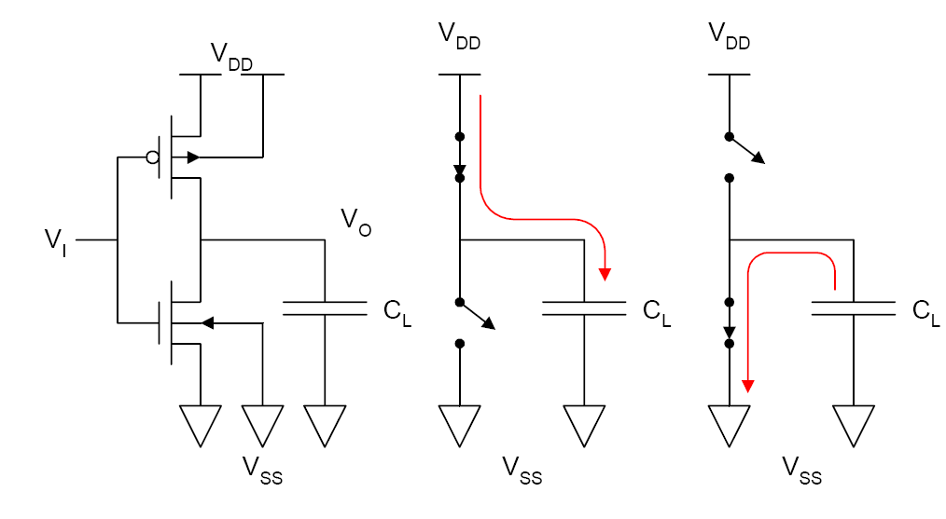
Switching Power
Example: CMOS inverter →
Required to charge and discharge C_{L}

Slide 5
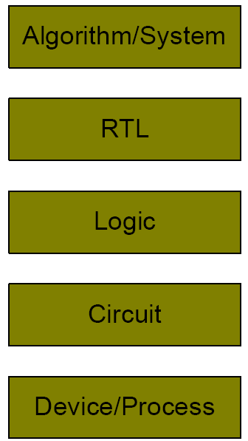
Power Reduction Design Space

Slide 6
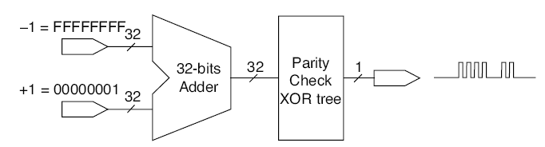
Glitch Reduction
Glitch is the unwanted transitions in the output before the stable state
How to reduce glitch?
  Inserting a register between the adder and parity checker

Slide 7
Clock gating
One of the most well-known low-power techniques
Disable transitions from propagating to parts of the clock path when the logic is inactive
The savings are mainly due to the switching capacitance reduction in the clock network
Clock-gating techniques have been successfully implemented in many microprocessors

Slide 8
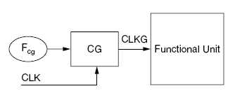
Clock gating
Functional unit has several FFs and other storage elements synchronized by clock
Fcg= the unit that calculates the gating conditions
CG= the unit that gates the clock
CLK= system clock
CLKG= gated clock

Slide 9
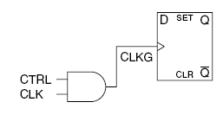

Clock gating
Is simply done by an AND gate

Slide 10
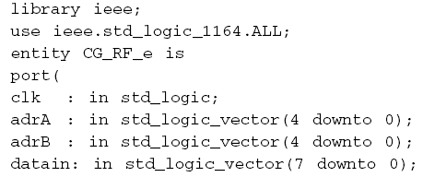
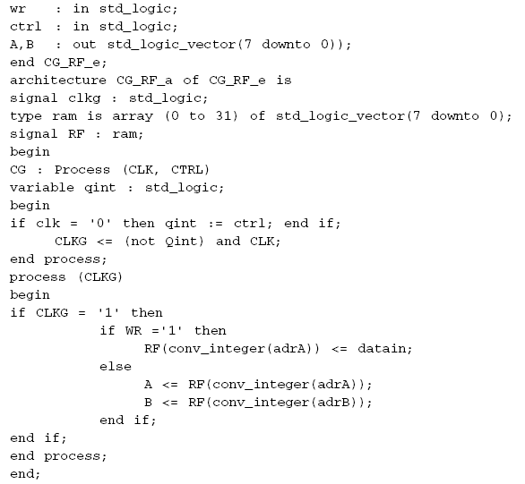
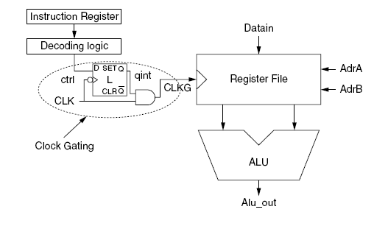
Clock gating

Slide 11
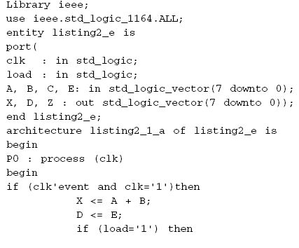
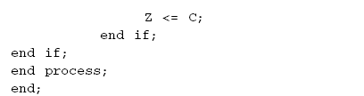
Clock gating
Conditionally executed parts of the VHDL code can be identified and separated: clock gating can be applied for each part

Slide 12
Clock gating
Some issues must be addressed
  Avoiding clock skew
  Determining which flip-flops should be grouped for clock gating

Slide 13
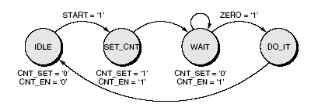
Gated-clock FSM
The basic idea of gated-clock FSM is that it is not useful to have switching activity in the next-state logic
Example:
Use the clock-gating techniques to freeze the clock and the input signals as long as the ZERO flag from the time-out counter is not raised
gate the clock
If FSM controls a datapath, gate the clock and mask the inputs of this datapath while we are in WAIT

Slide 14
Bus encoding
Wide and long buses consume a large amount of power mainly due to large capacitance and a significant switching activity
Bus inverting is a well-known method
  Before sending the data, the emitter compares its current value with the previous one and decides whether to send it or to send its inverted value along with a polarity signal.

Slide 15
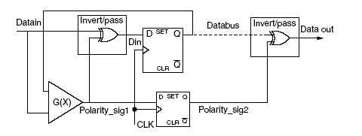
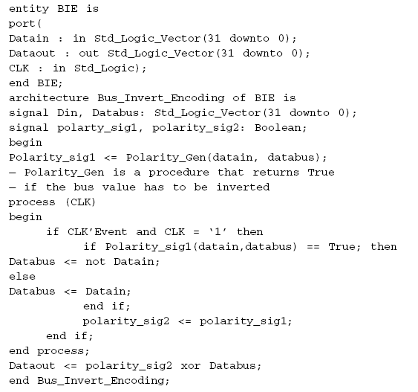
Bus inverting

